Slide 1

Project 2
Erich, Ricky, Isidro, and Sam

Slide 2
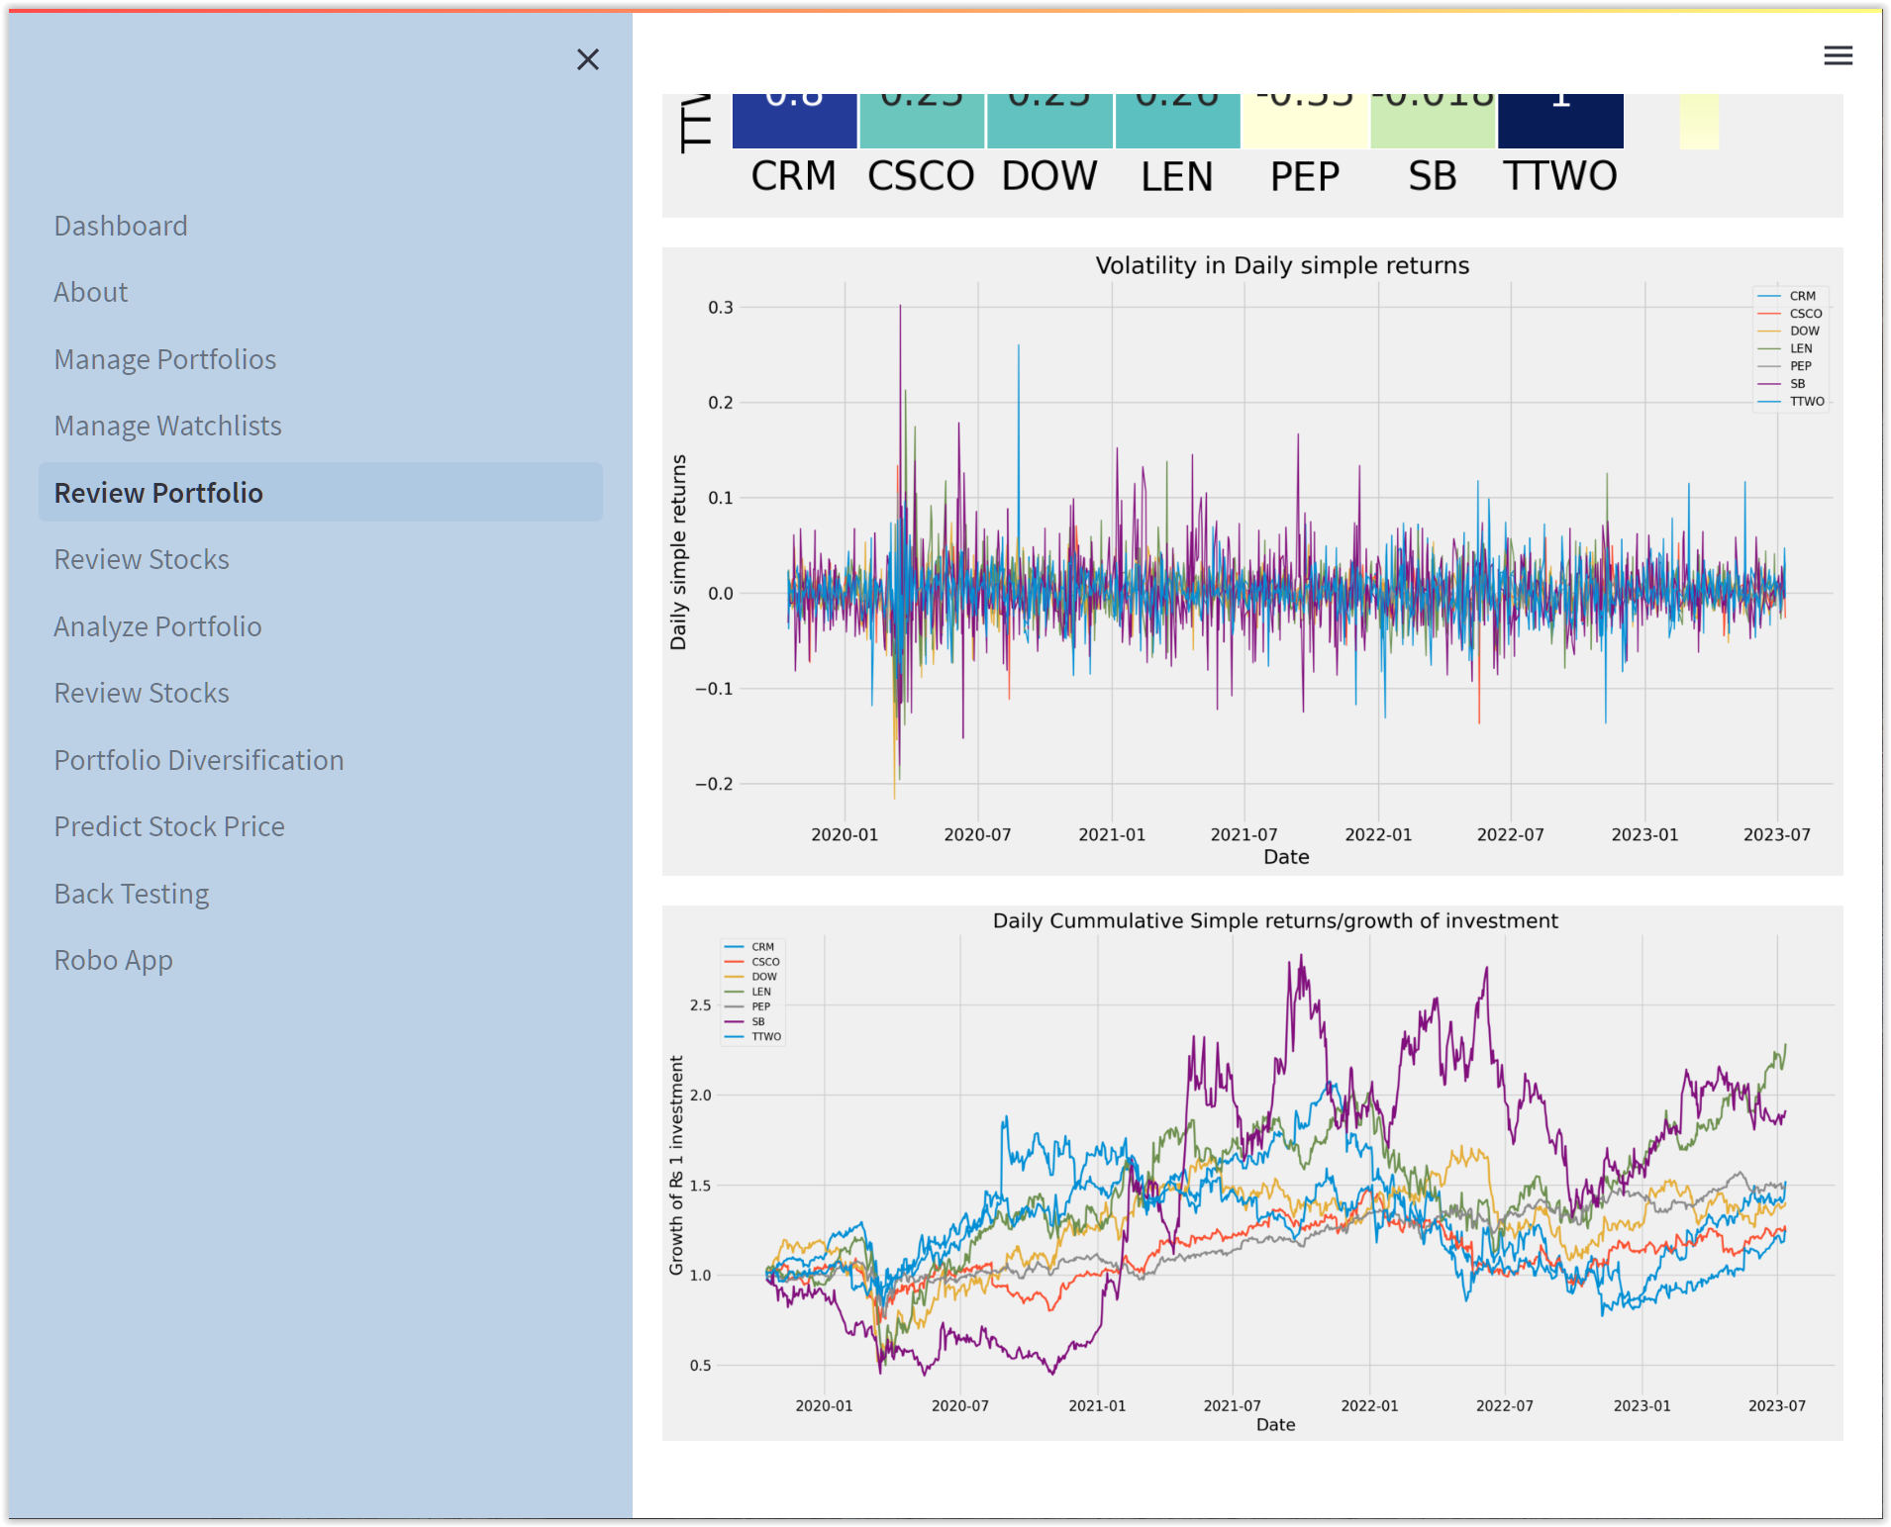

Slide 3
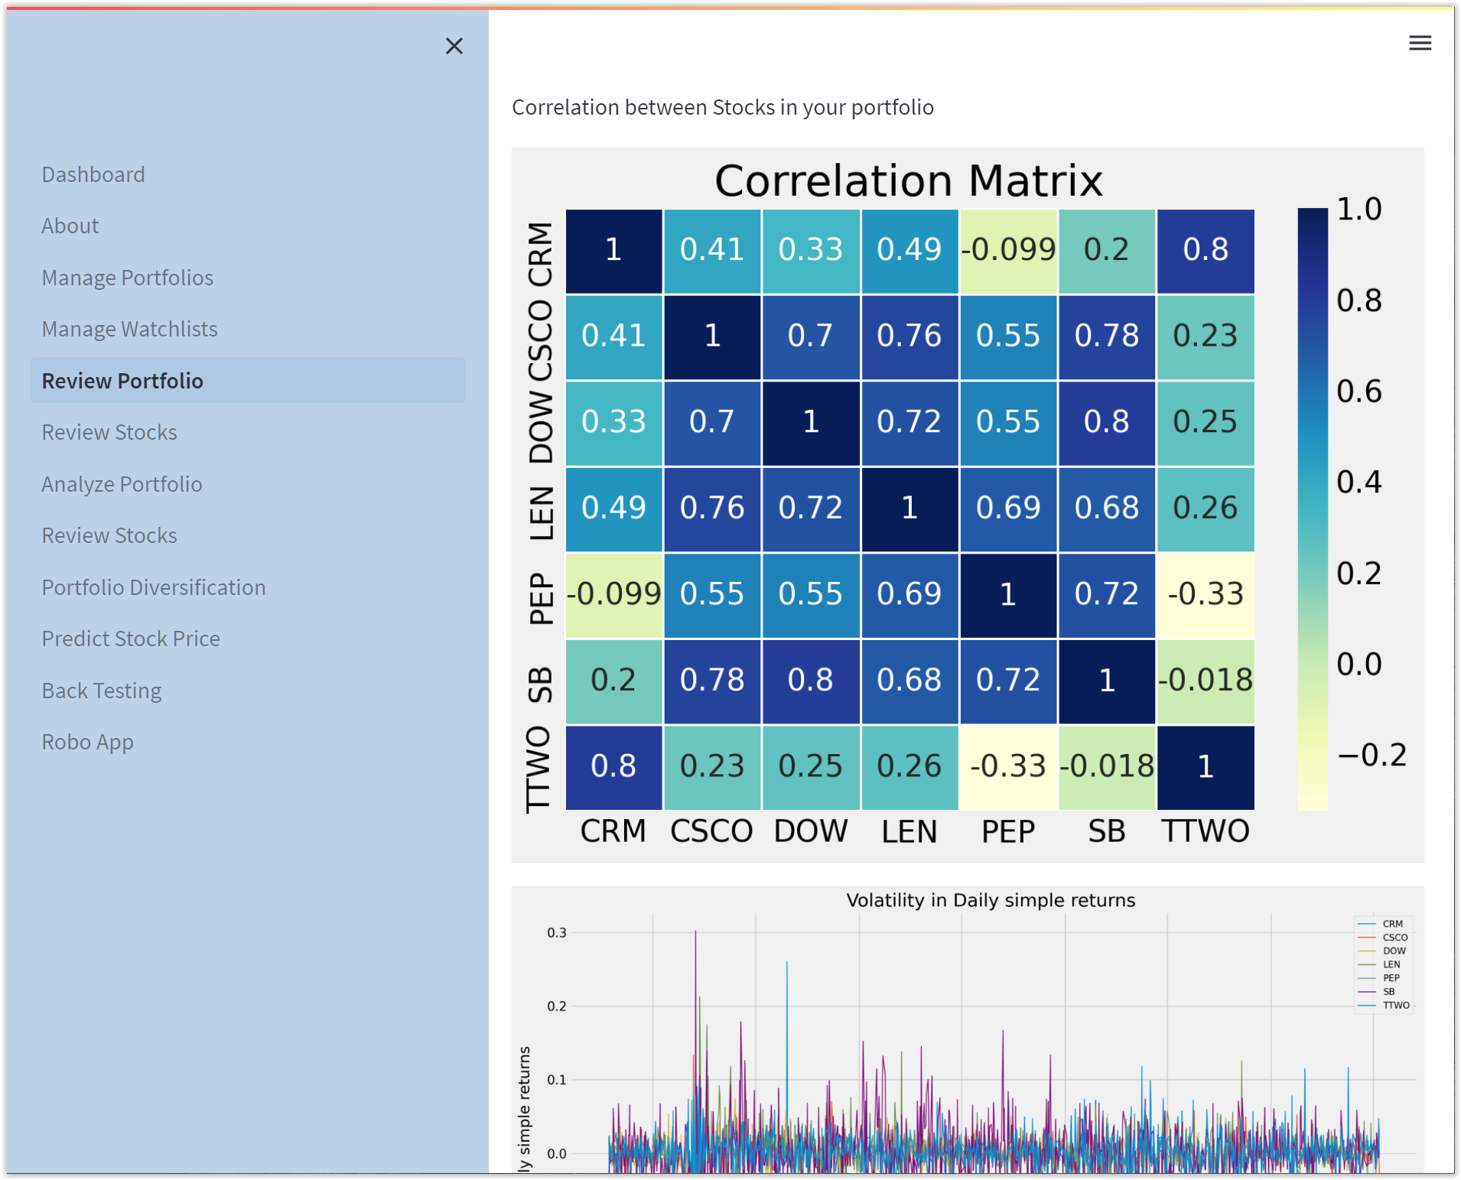

Slide 4
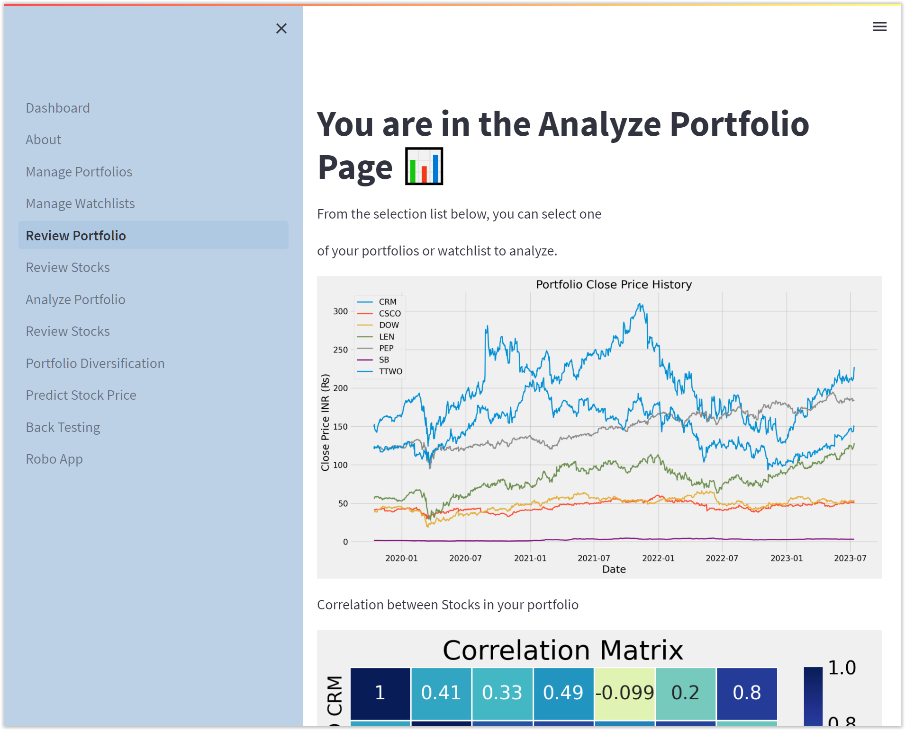

Slide 5
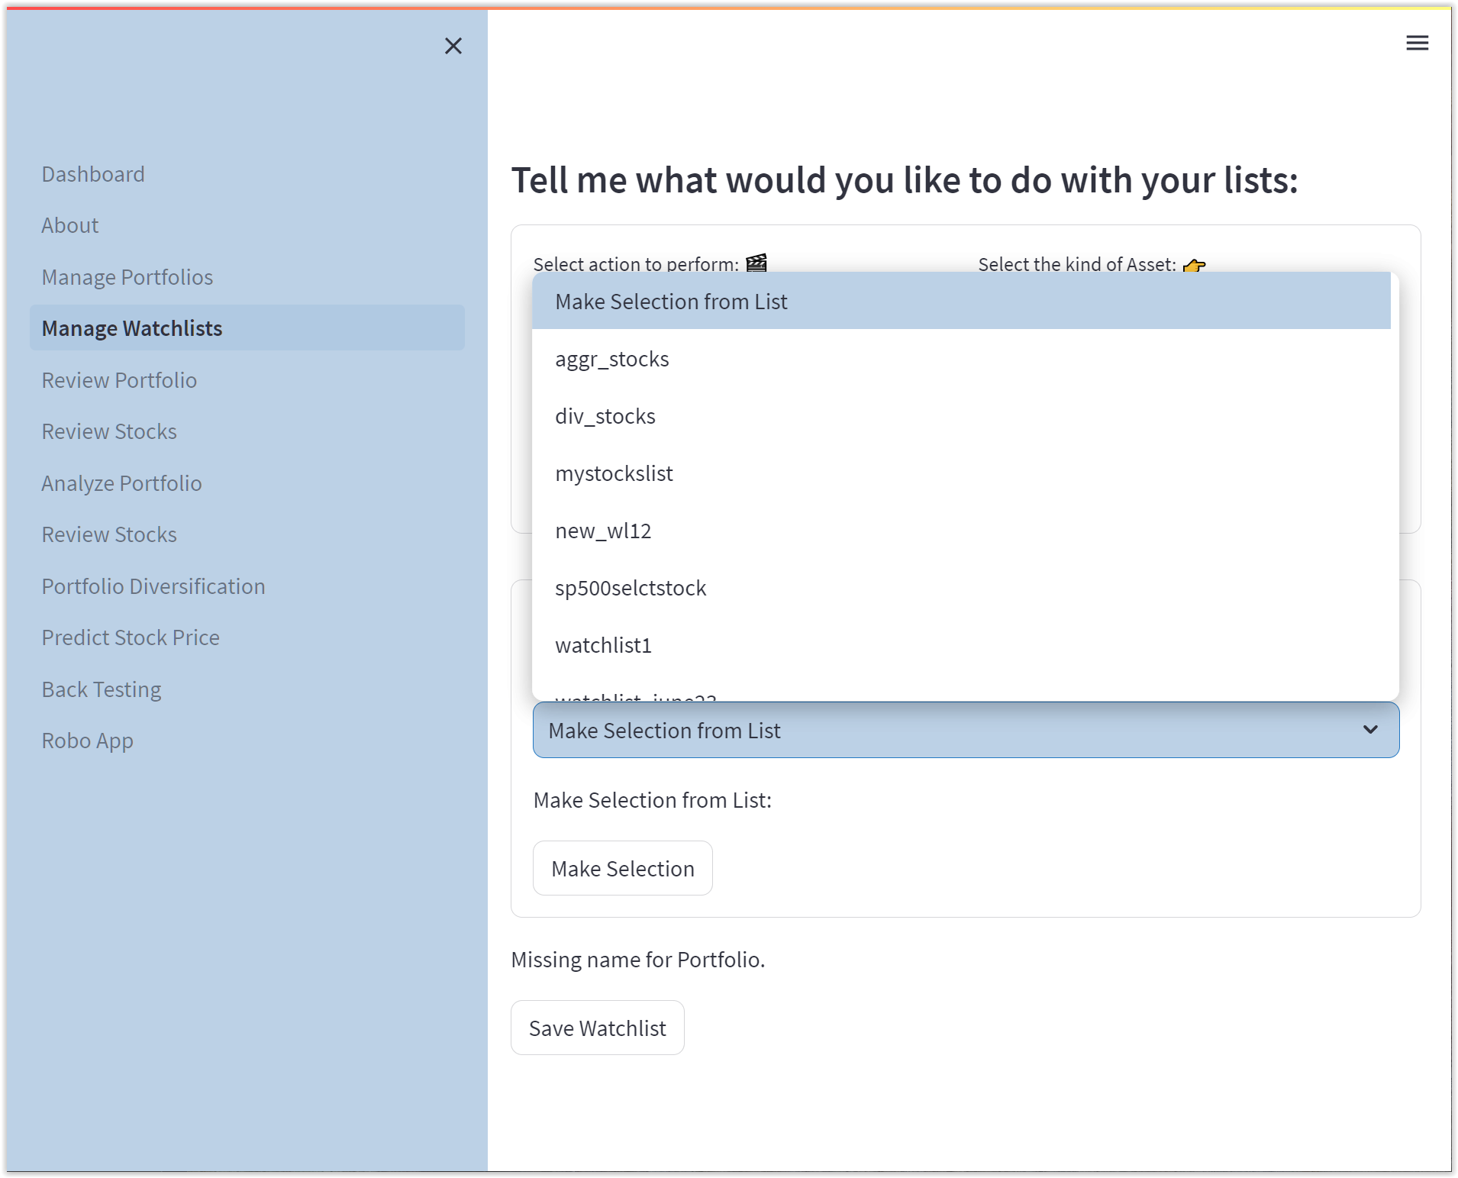

Slide 6
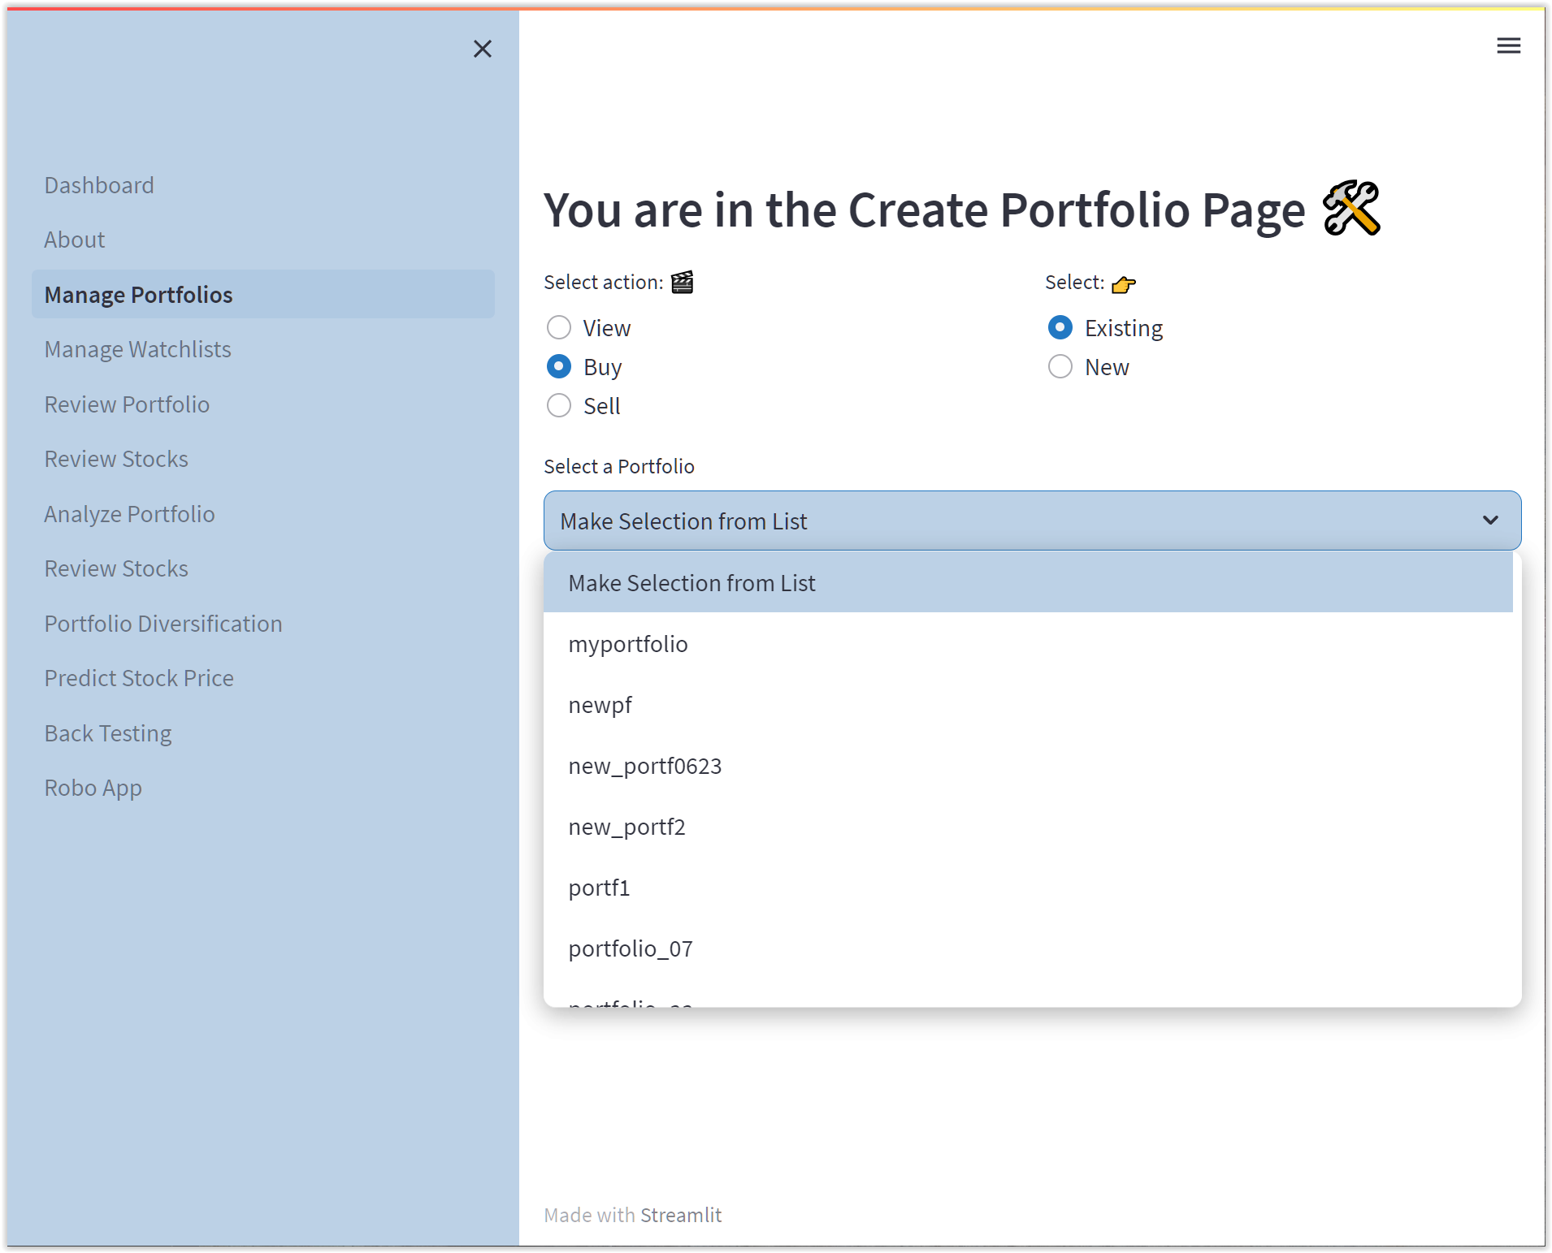

Slide 7
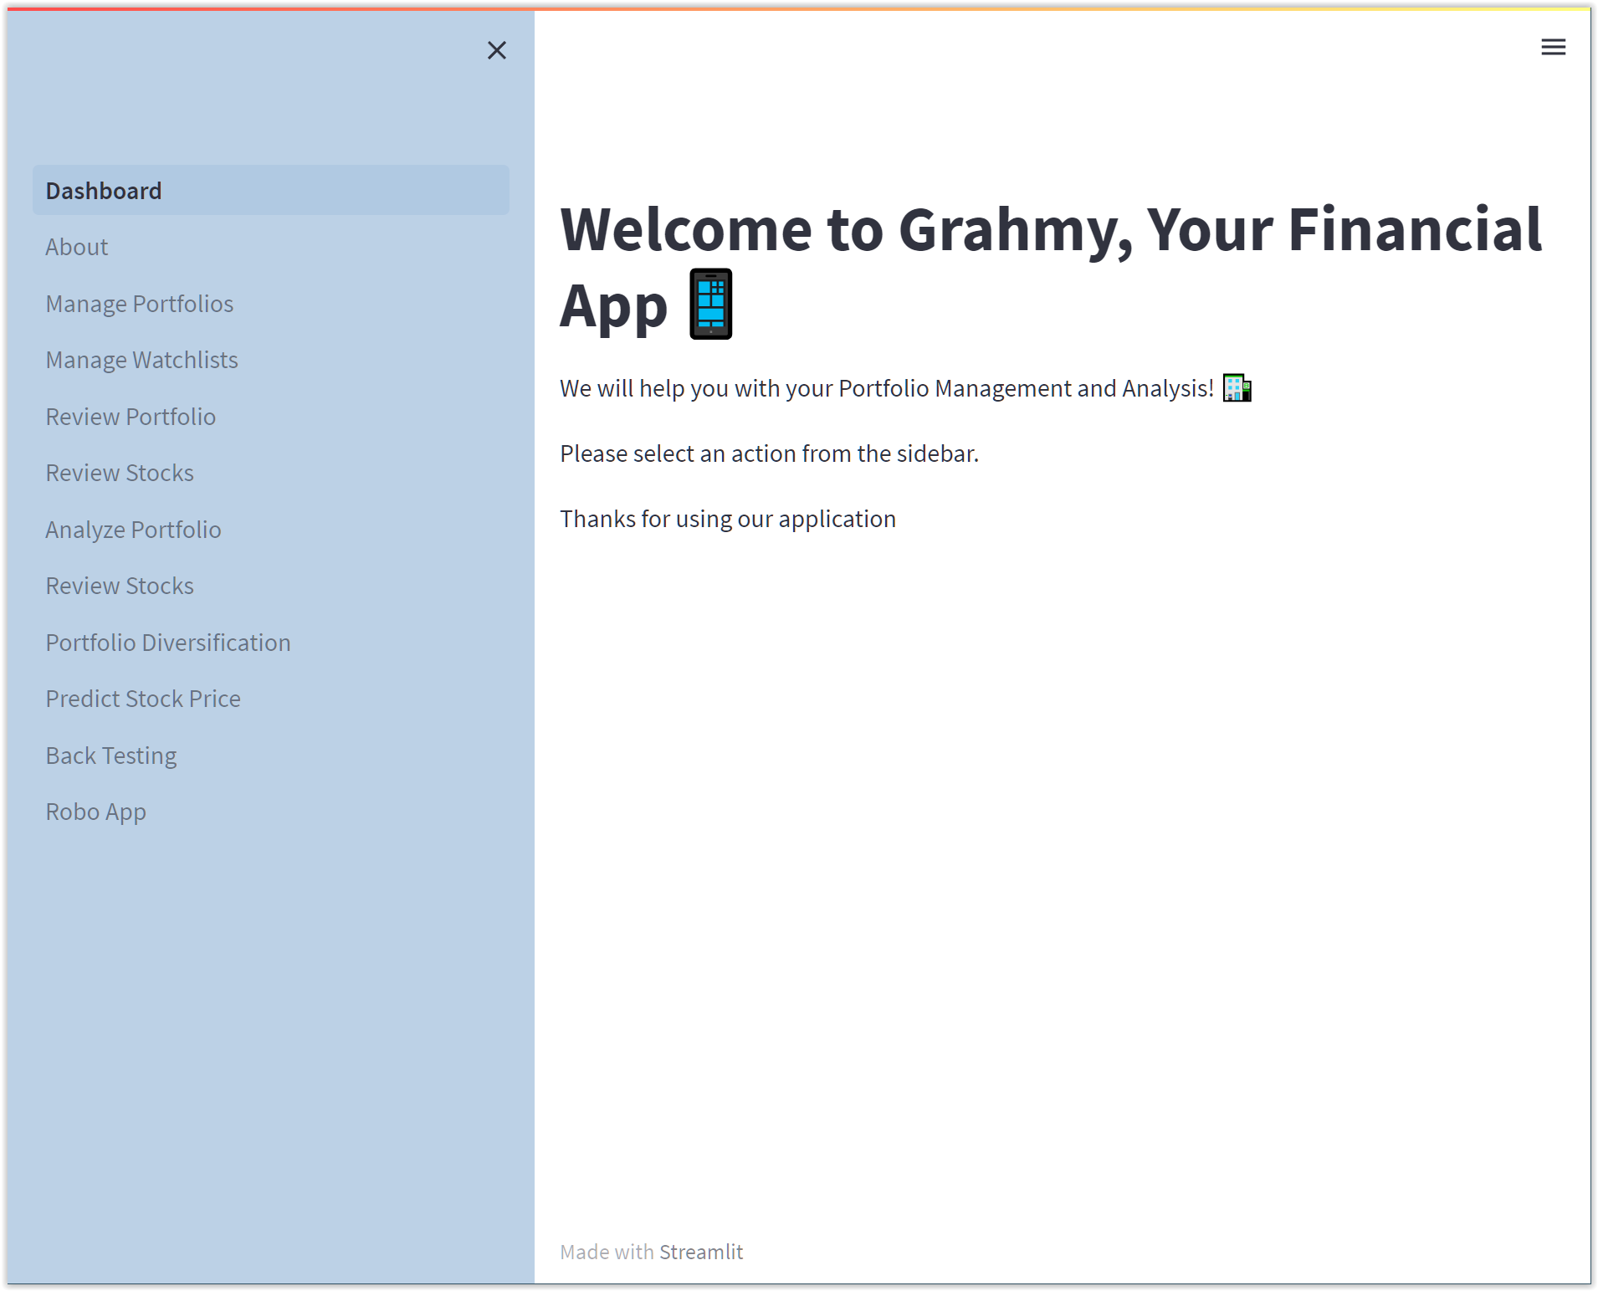

Slide 8
Defining Risk
Beta
The higher the beta the more volatile the stock
Industry
For example: technology sector tends to be more volatile than the healthcare sector
Market Cap
The smaller company the riskier and more volatile the stock tends to be riskier

Slide 9
Portfolio Types
Conservative
Focuses on preserving capital with least amount of risk
Could include bonds, and high-quality stocks
Balanced
Contains various types of assets such as stocks and bonds to reduce volatility
Aggressive
Goal is to maximize returns investing in riskier types of assets that have high beta and are generally sensitive to market fluctuations
Growth
Companies expected to grow sales faster than the market, often trade at a high P/E ratio
Income or Dividend
Investments that make money from dividends or distributions to share holders

Slide 10
Portfolio Recommendation:
A risk questionnaire will be given to clients to create a risk profile and score to guide clients to pick portfolio that best suits them:
Age
Willingness to take risk
Degree of phycological or emotional pain willing to face
Liquidity needs
Income
Tax rates
Investing experience
Reason for investing

Slide 11
Portfolio Performance
All portfolios based off $100,000 starting amount from 07/01/22 to 07/01/2023:
Growth
High P/E ratios
Holdings: PANW, LRCW, AAPL, AMZN, MSFT, TSLA ,CAT ,DE
Strategy Used: Triple Cross EMA (13, 30, 100)
Ending Balance: $96,343.77
% Gain or Loss: -3.66%

Slide 12
Portfolio Performance
All portfolios based off $100,000 starting amount from 07/01/22 to 07/01/2023:
Aggressive
Beta over 1
Holdings: TSLA, MSTR, FANG, CROX, AMD, NVDA, ALGN
Strategy Used: Triple Cross EMA (13, 30, 100)
Ending Balance: $113,349.34
% Gain or Loss: 13.35%

Slide 13
Portfolio Performance
All portfolios based off $100,000 starting amount from 07/01/22 to 07/01/2023:
Balanced
Mix of ETFs and bonds
Holdings: SPY, QQQ, IWM, TLT, SHV, AGG
Strategy Used: RSI (30, 70)
Ending Balance: $104,125.05
% Gain or Loss: 4.13%

Slide 14
Portfolio Performance
All portfolios based off $100,000 starting amount from 07/01/22 to 07/01/2023:
Conservative
Less volatile sectors
Holdings: KO, CI, PG, UNH, HD, CAT, LMT, XOM, CAH
Strategy Used: Bollinger Bands
Ending Balance: $96,833.27
% Gain or Loss: - 3.167%

